Slide 1
SRM IST – B.Tech .ECE
WI PRO
WESTERN I NDI A PALM REFI NED OI LS LI MI TED

Slide 2



TABLE OF
CONTENTS
WIPRO's Profile
Products Services
Industries / Clients
Insights - Digital transformation Insights - Technology Trends Career Oppurtunities

Slide 3
WI PRO'S PROFILE
Our Philosophy
Wipro's company values of respect, responsibility, integrity and trust mean that it is committed to contributing to the communities in which it works.
Our Vision & Mission Our Values
Our Capabilities
Across cloud computing, cyber security, digital transformation, AI, robotics, data analytics and other technology to 167 countries.
Continous effort to enhance people's liestyle and quality by means of developing new technology in wireless Comm.
Being Respectful, Responsive, Always Communicating, Demonstrating Stewardship & Building Trust .

Slide 4
WI PRO PRODUCTS

Slide 5

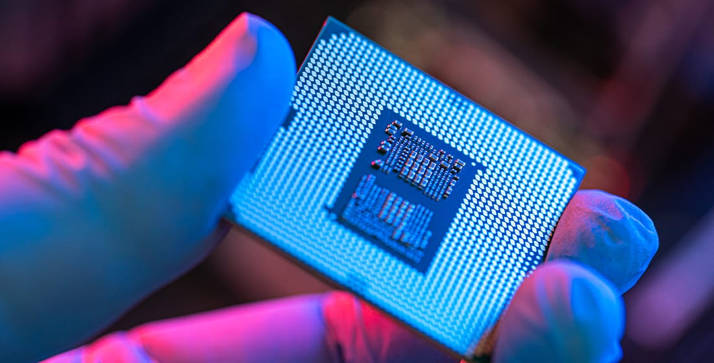
WIPRO SERVICES
We don’t make chips. We make them more impactful.
The world’s top semiconductor companies trust Wipro to bring transformational silicon solutions to market.
Helps to design, test and modernize chips and integrated systems is just the beginning.

Slide 6

WIPRO INDUSTRY
Human Centered AI solutions are designed to understand and anticipate changes in customer behavior, determine the underlying intent and drivers, draw behavioral inference and nudge them to make better choices.
The solutions are developed on the principles of responsible AI.

Slide 7
BENEFITS
Informed decision-making: The goal of human-centered AI is not to replace humans entirely but to enhance our capabilities by way of intelligent, human-informed technology.
Through its combination of the precision of machine learning with human input and values, human-centered AI enables businesses (specifically, the humans in the business) to make more informed decisions and develop clearer strategies and solutions to challenges.

Slide 8
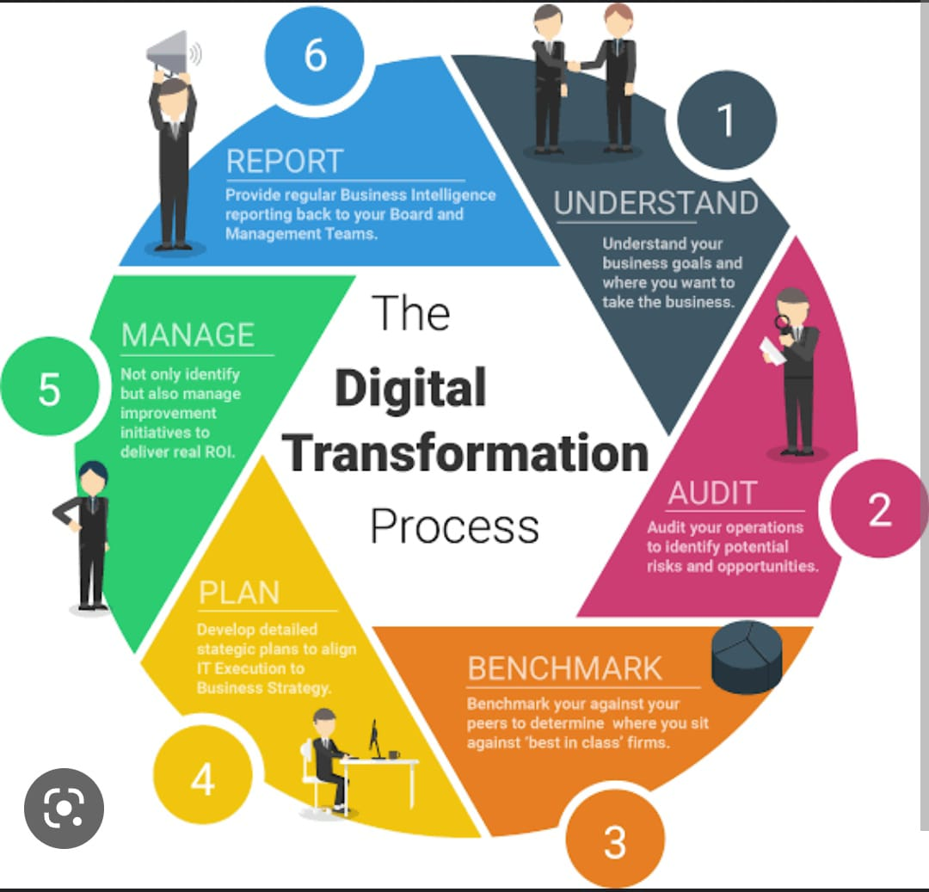
DIGITAL TRANSFORMATION

Slide 9
DIGITAL TRANSFORMATION
Digital transformation has been a part of our lexicon for nearly six years. Yet, there’s hardly consensus on what it means. Maybe it’s time to recognize it served its purpose to galvanize business leaders around a needed change in their business to become more digital.
But now, it may be holding CEOs back from fulfilling the potential of their digital agenda through a much wider and needed enterprise transformation.

Slide 10
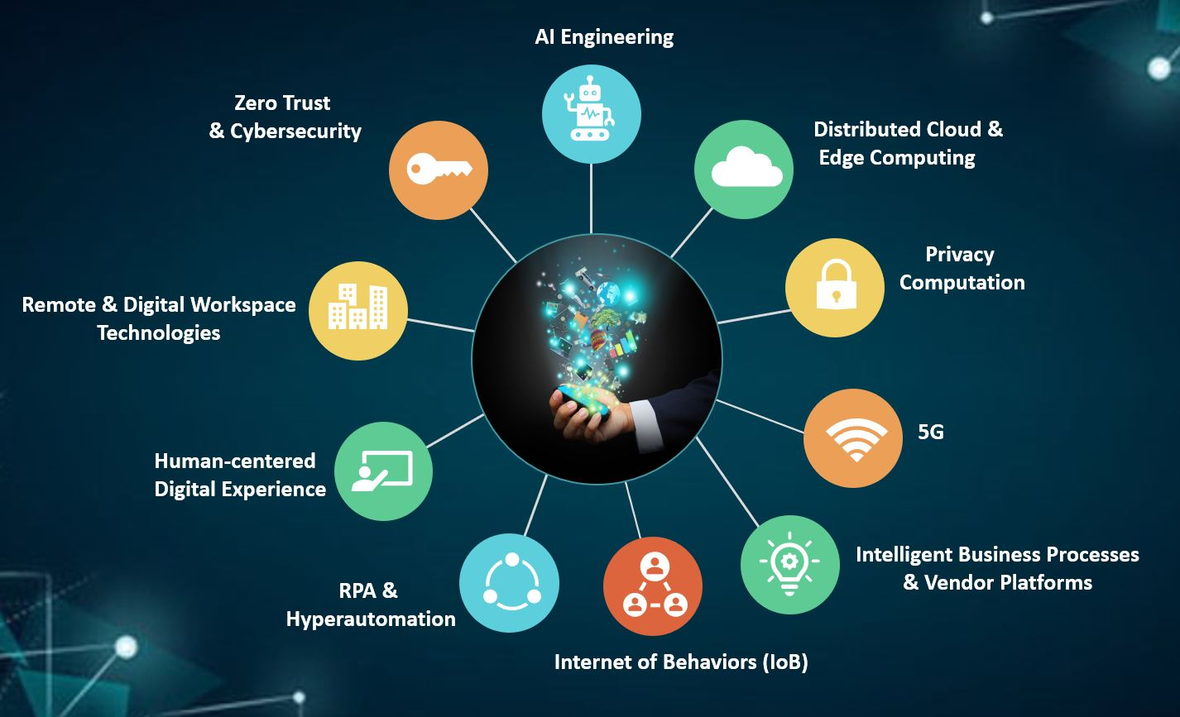
TECHNOLOGY TRENDS
Technology continues to be a primary catalyst for change in the world.
Technology advances give businesses, governments, and social-sector institutions more possibilities to lift their productivity, invent and reinvent offerings, and contribute to humanity's well-being.

Slide 11

CAREER OPPORTUNITIES
Having a fulfilling career is an important part of your well-being.
A crucial step while charting your career path is to identify and choose the right opportunities.
Choosing a career opportunity becomes easier when you know what options you have.

Slide 12
CAREER OPPORTUNITIES
At Wipro, we endeavor to provide a formidable platform for professionals who will be our change agents – catalysts who will be torchbearers of Wipro’s fortitude to excel and redefine limits of technology to make our clients successful.
As technology finds its way into practically every aspect of an organization's functions, we are always on the lookout for the right people for the right job.
It’s also true that any job at Wipro eventually morphs into a promising career that opens up more growth avenues in the future.
Whatever is your area of expertise, we might surprise you with something that challenges, inspires, and delights you.

Slide 13
CAREER OPPORTUNITIES
Usually Wipro will consider B2 or above band people for on-site projects.
On-site Opportunities purely depends on project requirement.
It takes 3-4 years for a fresher to get on-site Opportunity.
Career growth depends upon project domain you are working in.
The company has entered into the global market, so now it's biggest Opportunity available to the company.

Slide 14
PRESENTED BY
THANK YOU
F.M. KARLYN CYNTHIA
R. VAISHNAVI
G. GAYATHRI
R. DEEPA

